Slide 1
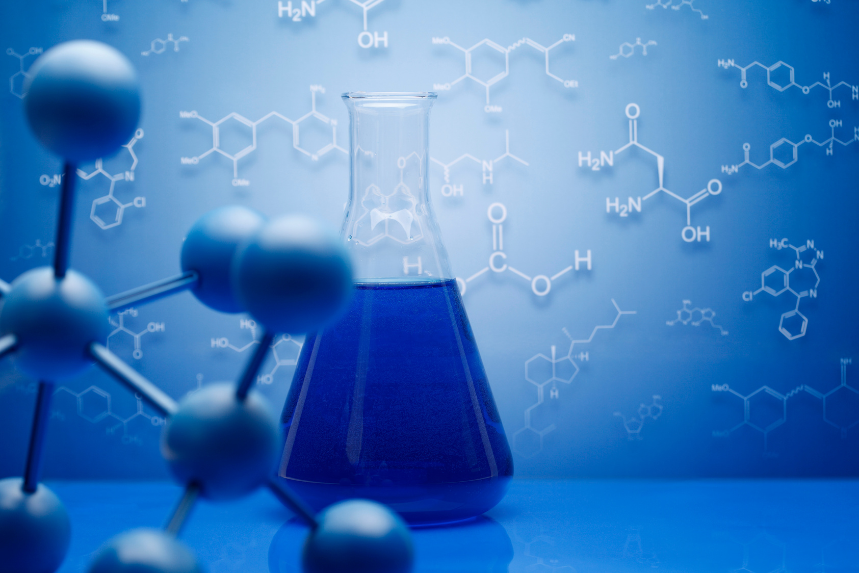


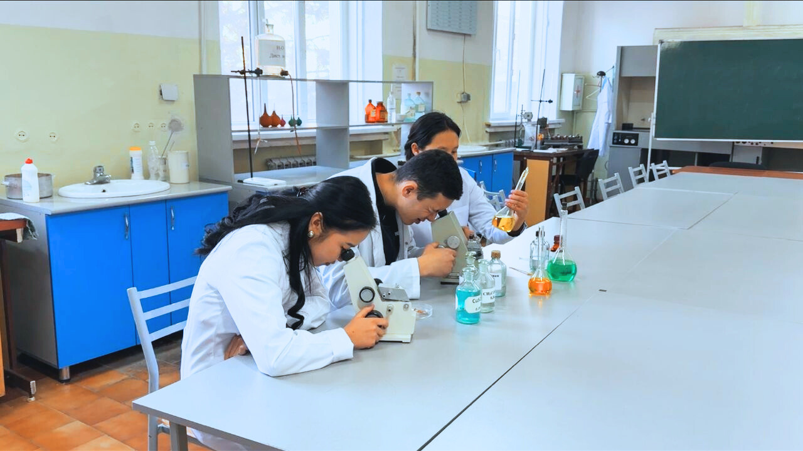

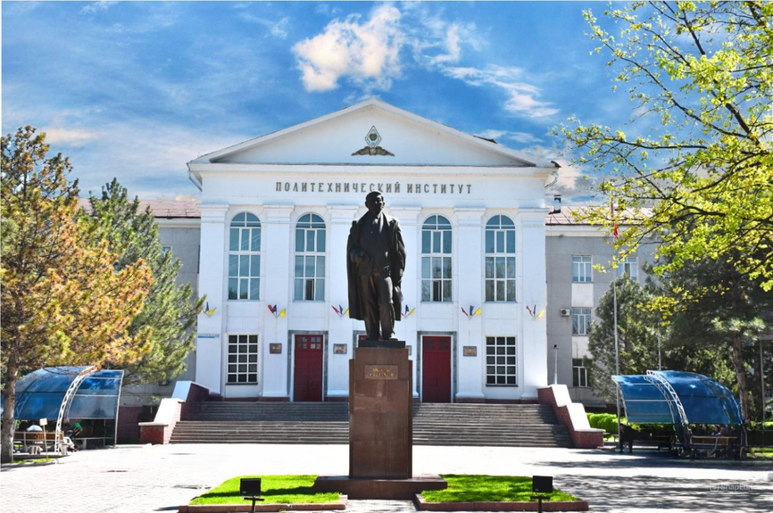


INSTITUTE OF TECHNOLOGY
DEPARTMENT OF CHEMISTRY AND CHEMICAL TECHNOLOGIES
OU WANT TO GET THE MOST MODERN, IN-DEMAND AND HIGHLY PAID JOB!
ENROLL IN THE DIRECTION OF "CHEMICAL TECHNOLOGIES",
profile
RESEARCH CHEMI
DEPARTMENT OF CHEMISTRY AND CHEMICAL TECHNOLOGIES I AM GLAD TO MEET YOU!
Our address: 66 Ch. Aitmatov Avn.,
I. Razzakov KSTU, office 1/234
Tel. (0312) 54-19-21 (admission committee)
Contact person: Moldokanova Dinara Amanturovna
Tel. 0312561502, Mobile 0502208010
e-mail: moldokanova1978@mail.ru

Slide 2
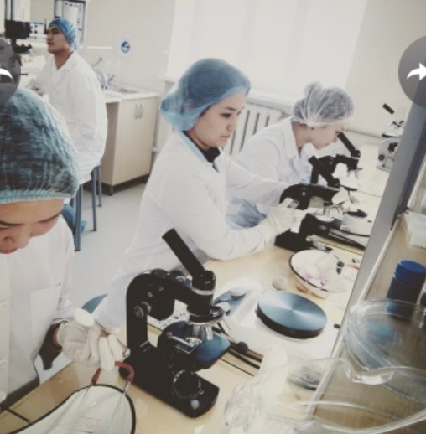
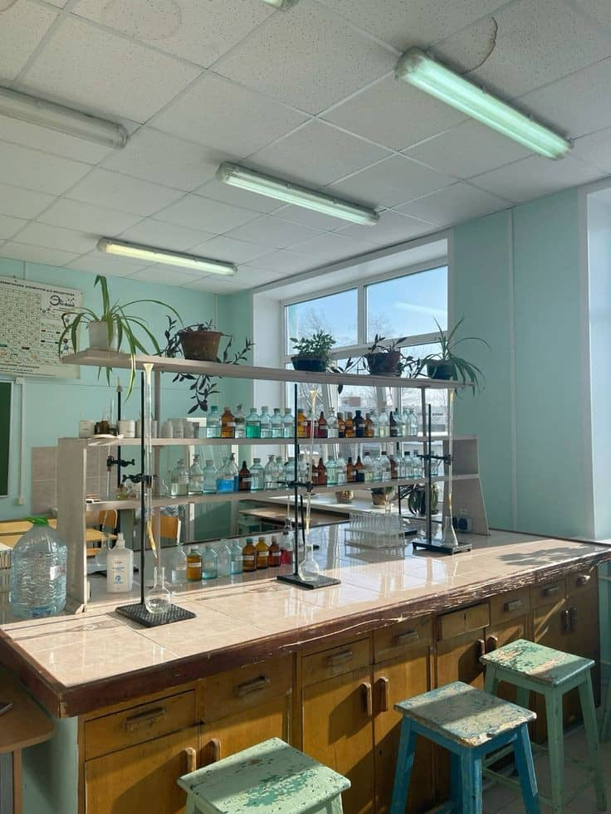
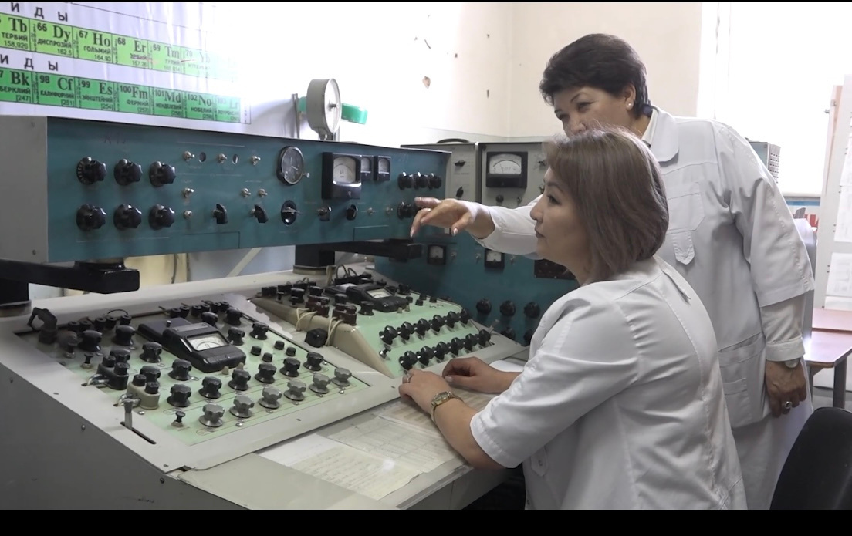
Currently, mining enterprises for gold, antimony, copper, rare earth metals and other minerals, enterprises for the extraction and processing of oil and gas, food enterprises, quality control systems for raw materials and finished products, control and purification systems for the environment, air and soil are in extremely urgent need of research chemists. Why? Because a professional research chemist who knows modern methods of analysis (spectroscopy, X-ray, chromatography, etc.), knows the appropriate production technologies, is able to systematize and make correct conclusions and conclusions on the substance or process under study – is one of the most important participants in any production process or experimental research.
Research chemists are in demand in all spheres of human activity: In educational and research, activities, in the food industry, medicine, pharmaceuticals, oil refining, manufacturing, metallurgy, etc.
The high scientific and professional potential of the department provides high-quality education, which allows you to continue your education in master's, postgraduate, PhD.
During their studies (4 years), students undergo a full course of chemical disciplines: inorganic and orgonic chemistry, analytical chemistry and physical and chemical methods of analysis, physical and colloidal chemistry, oil and gas chemistry, general chemical technology, quantum chemistry, scientific research methods, research workshop nanotechnology, etc.
Graduates can be employed in chemical and production laboratories of the mining and industrial complex (CJSC Kumtor Gold Company, JSC Jeruy, etc.), in the laboratory of an oil refinery (Junda Kara-Balta), in the laboratories of food enterprises (Shoro OJSC, etc.), in the laboratories of Kyrgyzstandart, in the pharmaceutical plant of the Biovit company, as well as in the testing laboratory of the Stuart Essay and Environmental Laboratories LLC, educational and research institutions, to study for a master's degree, postgraduate, doctoral studies PhD.
The preparation and graduation of bachelors of this educational program is carried out by the Department of Chemistry and Chemical Technologies, established simultaneously with the opening of the Frunze Polytechnic Institute (FPI) in 1954.
To enroll in this educational program, you must pass the main test and an additional “Chemistry” test.

