Slide 1



Heuristical Approach of logistic
Problems
Dr. Péter Veres
04. 15. 2021 Logistics 4.0 Conference

Slide 2

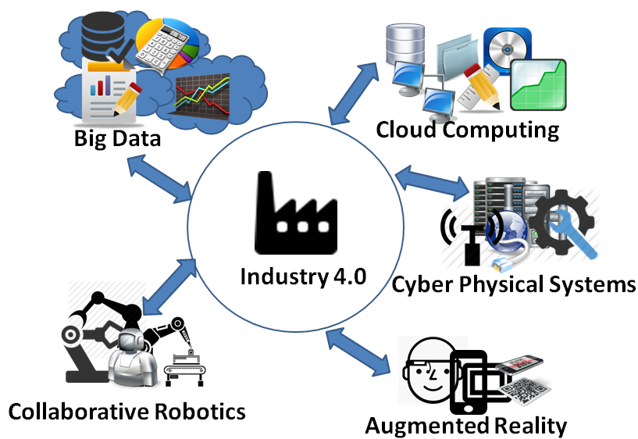

Principles of present day
Globalization, Industry 4.0, Internet of things, Machine learning, Neural networks etc… have great effects on modern manufacturing and service sector.
Comprehensive global-scale networks have emerged.
NP-hard problems occurs within these complex systems.

Slide 3
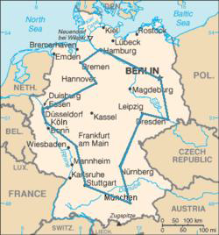
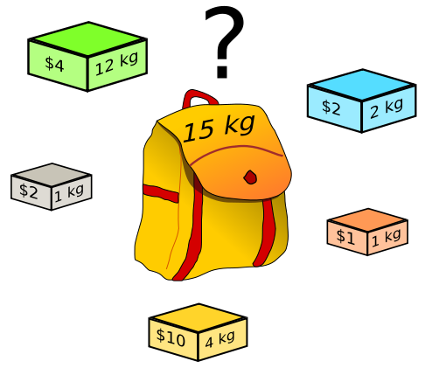
Basic problems in Logistics
Routing (Traveling salesman)
Capacity management (Kanpsack)
Location determination (Center search)
Production depth determination (Make or Buy)
Scheduling
ETC…

Slide 4
Tools for solution
Simple mathematics and Linear Programming
Reliable
Fast
Always gives solution(s)
Usually easy to use or convert for application
Usually can’t work efficiently with big and wide variety of datasets
It specializes for only one problem

Slide 5

Location determination
23
14
30
16
11
9
20
13

Slide 6
Area grid method
23
14
30
16
11
9
20
13

Slide 7
Area grid method

Slide 8
Area grid method

Slide 9
Area grid method

Slide 10
Area grid method

Slide 11
Area grid method

Slide 12
Area grid method

Slide 13
Area grid method
23
14
30
16
11
9
20
13

Slide 14
Area grid method
23
14
30
16
11
9
20
13

Slide 15
Features of this method
Pros
  Easy to use
  Easy to understand
  Fast
  Reliable
Cons
  Can only be used when all parameters given
  Only solve this kind of problem
  The solution is a wide area

Slide 16
Tools for solution
Simple mathematics and Linear Programming
(Meta)heuristic Algorithms and non-exact methods
Reliable
Fast
Always gives solution(s)
Usually easy to use or convert for application
Usually, can’t work efficiently with big and wide variety of datasets
It specializes for only one problem
The only effective option in real-time working databases and networks
Can use in multiple problem
Teachable
Mostly reliable,
Hard to program and configure

Slide 17
BASics I.
An algorithm, or rather a process, is a method, instruction, detailed guidance or recipe that can be used to solve a problem
Heuristics is the art of discovery of new truths, with a process of getting good results without strictly logical or mathematical explanation. For example: rule of thumb, instinctive feeling, estimation, outline, common sense. Instead of using unified algorithms to solve a problem, different methods based on attemps, aproximation and prediction with the help of experience and gathered data could be used also.

Slide 18
Basics II.
The heuristic algorithm is a method that in every junction (branch) within each step gives alternative solutions with search algorithms based on the information available, which they rank and decide the best solution, which will be the branch the solution will follow. Otherwise: In heuristics, the goal is to create a solution within a reasonable time that is good enough to solve the problem.
A metaheuristic algorithm is a higher-level process that generates, search, or selects a heuristic or LP methods for (a step in) the optimization problem in order to achieve an acceptable solution. Especially useful in a situation where we have incomplete, incorrect or inadequate input information or have limited computing power. Metaheuristics impose few conditions so they can be applied to many problems.

Slide 19
Basic heuristic methods
Psychology:
  Rule of thumb
  Intuitive judgement
  Guesstimate
  Common sense
Engineering:
  Practical formulas
  Measured (Dimensionless) variables
  Mechanical diagrams

Slide 20
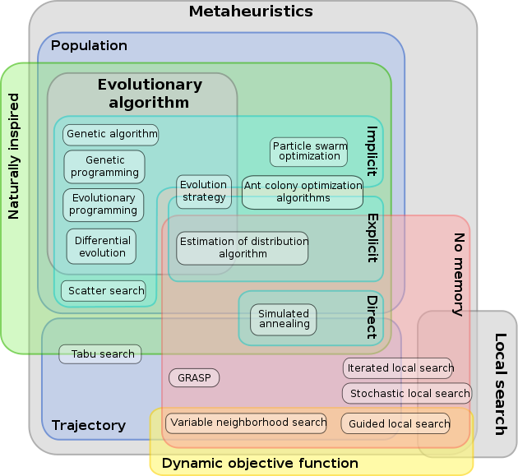
List of metaheuristic algorithms
Harmony search (HSA)
Krill Herd algorithm (KH)
Lightning Search Algorithm (LSA)
Monarch Butterfly Optimizatio (MBO)
Moth-Flame Optimization algorithm (MFO)
Multi-verse optimizer (MVA)
Particle swarm optimization (PSA)
Ant colony optimization (ACA)
Ant lion optimizer (ALA)
Artificial bee colony algorithm (BCA)
Bat algorithm (BA)
Biogeography-based optimization (BBO)
Brain Storm Optimization Algorithm (BSO)
Cat swarm optimization (CS)
Crow search algorithm (CSA)
Cuckoo optimization algorithm (CKOA)
Cuckoo search algorithm (CKSA)
Differential evolution (DEA)
Dragonfly Algorithm (DA)
Earthworm Optimization Algorithm (EWA)
Elephant Herd Algorithm (EHO)
Evolutionary Strategy (ES)
Firefly algorithm (FA vagy FFA)
Flower Pollenation Algorithm (FPA)
Genetic algorithm (GA)
Glowworm swarm optimization (GSOA)
Gravitational search algorithm (GSA)
Grey wolf optimizer (GWA)

Slide 21


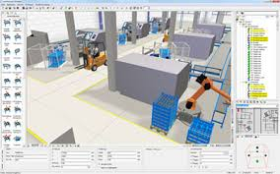
Where MHA are used?
AI research, Machine learning, Neural networks
Searching in databases (Google, online shop, etc.)
Inside simulation tools and software (weather, dynamic CAD)
Inside logistic planning software (eg. route-planning)
Almost every software!

Slide 22
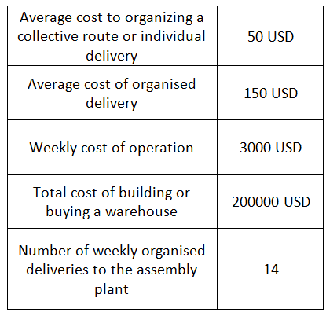
Multi center search example
The assembly plant is in the middle of the search space 100x100km.
The black dots are the 20 suppliers scattered, working with the costs in the table. The number next to the black dots are the weekly deliveries.
Find the best positions for warehouses, if their number is 1 up to 10.

Slide 23

The MAP

Slide 24
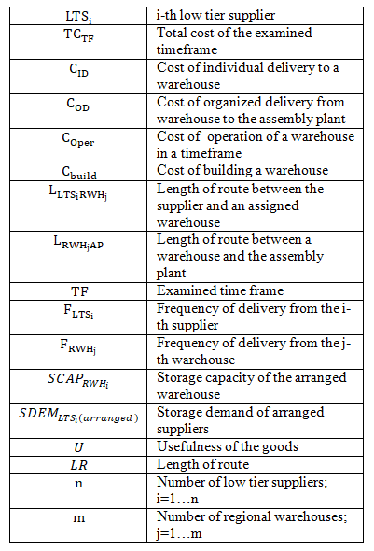
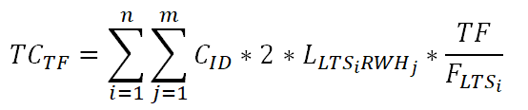
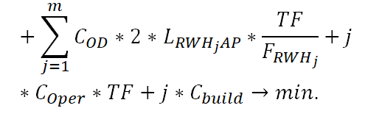
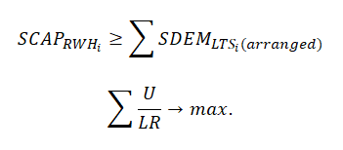
The mathematical model

Slide 25
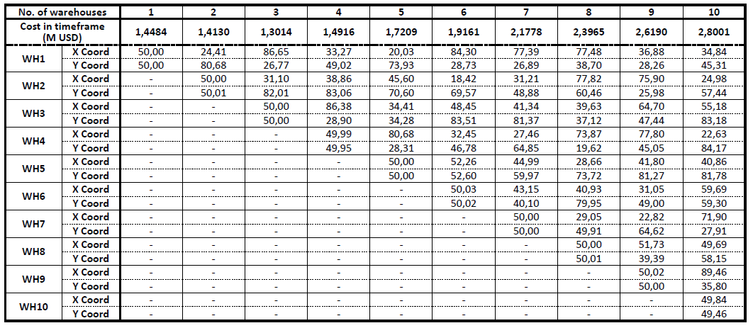
The locations of Warehouses

Slide 26
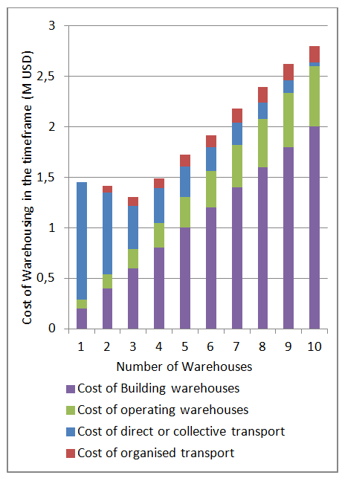
The solution
Optimal

Slide 27
Thank you for your attention!

